Slide 1

Phenotyping: step by step
Albert Prats- Uribe
Senior Clinical Research Fellow in Public Health and Epidemiology
Health Data Sciences
Botnar Research Centre, NDORMS

Slide 2
AGENDA
Phenotyping in RWD
Federated networks and tools
Phenotyping OMOPped data
The DARWIN EU® Phenotyping SOP

Slide 3
AGENDA
Phenotyping in RWD
Federated networks and tools
Phenotyping OMOPped data
The DARWIN EU® Phenotyping SOP

Slide 4
Phenotyping in RWD: The Problem
Finding patients that:
      Have or had certain disease
      Use/d certain treatment (drug or surgeries)
      With certain characteristic/s

Slide 5
1st - Define
Have or had certain disease
Notice: phenotypes are cohorts (time-bound features)
For example: Diabetes

Slide 6
Diabetes in the clinic
Symptoms
a random venous plasma glucose concentration ≥ 11.1 mmol/l or
a fasting plasma glucose concentration ≥ 7.0 mmol/l (whole blood ≥ 6.1 mmol/l) or
two hour plasma glucose concentration ≥ 11.1 mmol/l two hours after 75g anhydrous glucose in an oral glucose tolerance test (OGTT).
Tests
An HbA1c of 48mmol/mol (6.5%) is recommended as the cut off point for diagnosing diabetes
feeling very thirsty
peeing more frequently than usual
feeling very tired
weight loss and loss of muscle bulk
itching, or frequent episodes of thrush
blurred vision
-Screening e.g. NHS Health Check
Diagnosis
With no symptoms diagnosis should not be based on a single glucose determination but requires confirmatory plasma venous determination

Slide 7
Diabetes in Real life
Treatment
Complications: Long term
Short-term problems
Diet and exercise
Insulin
Tablets: Metformin and others
Weight loss surgery
Eye problems – retinopathy
Foot problems – Diabetic foot disease
Heart attack and stroke
Kidney problems - nephropathy
Nerve damage - neuropathy
Gum disease and other mouth problems
Related conditions, like cancer
Sexual and genitourinary problems
Hypos –blood sugars are too low
Hypers– blood sugars are too high
Hyperosmolar Hyperglycaemia – emergency by severe dehydration and very high blood sugars.
Diabetic ketoacidosis

Slide 8
Diabetes in RWD
Symptoms
Tests
Diagnosis
Treatment
Long-term
complications
Short-term
complications

Slide 9
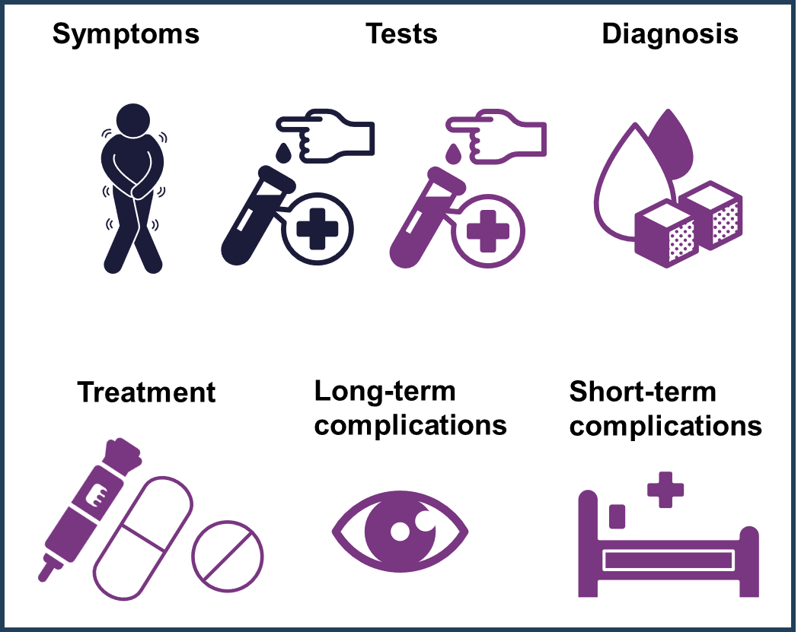
Diabetes in RWD

Slide 10
Diabetes in Multiple Datasets
Symptoms
Tests
Diagnosis
ICD-9
ICD-10
MeSH
Read (e.g. CPRD GOLD)
SNOMED (e.g. CPRD AURUM)
Cpt4
Edi
MeSH
Read
SNOMED
ICD-9
ICD-10
MeSH
Read
SNOMED
Long-term
complications
Short-term
complications
Treatment
Dm+d
MeSH
SNOMED
ATC
ICD-9
ICD-10
MeSH
Read
SNOMED
ICD-9
ICD-10
MeSH
Read
SNOMED

Slide 11
AGENDA
Phenotyping in RWD
Federated networks and tools
Phenotyping OMOPped data
The DARWIN EU® Phenotyping SOP

Slide 12




Federated Analytics
Local Governance
EMR
LIMS
Rx
Dx
Admin
…
Local
Database
OMOP
Database
EHDEN will develop new tools and dashboards.
Local Governance
EMR
LIMS
Rx
Dx
Admin
…
Local
Database
OMOP
Database
Analysis query
The EHDEN platform
Aggregated results
Local Governance
EMR
LIMS
Rx
Dx
Admin
…
Local
Database
OMOP
Database
Many different open source tools (cohort builder, estimation, incidence rate, ….)
ATLAS
Notes:
On the left side of this diagram, you see three examples of individual sites. The health data is stored in a local database and each site maps its database to the common data model, called OMOP, to ensure harmonisation amongst the different network partners. Each site also has the applications in place to interrogate or analyse their own data or to execute an analysis script that is developed centrally – by other partners of the EHDEN network.
The individual sites are not physically connected to a central platform but information can be shared through the EHDEN portal. It’s a secured environment that is only accessible to partners.
In EHDEN, the tool called Atlas is used, which is already available as part of OMOP. It can be used to define virtual cohorts using combinations of in- and exclusion criteria. Several routine analyses will come pre-packaged for download from the portal so that they can be executed locally. Study-specific scripts will be developed and made available in the same way but accessibility will be restricted to those partners participating in a particular research question. The scripts can accommodate all state-of-the art analytical programming languages such as Python, R, SAS, SQL. Support for Big Data tools and machine learning is also enabled (Spark, Apache Drill, Scikit-learn, H2O).
The portal itself will be accessible for the partners through a dedicated, password-protected EHDEN website.
As you can see, local data stays local at all times. The pre-developed analysis scripts are run locally and only the results are transferred to the EHDEN portal. The local governance rules apply and you can also decide for each single research question, if you would like to participate or not.

Slide 13
The OMOP common data model
Standardized clinical data
Standardized health system data
Standardized meta-data
Person
Observation period
CDM source
Location
Care site
Specimen
Provider
Standardized vocabularies
Patient-centric
Tabular
Extendable
Built for analytics
Relational design
Death
Concept
Standardized health economies
Visit occurrence
Payer plan period
Vocabulary
Procedure occurrence
Domain
Cost
Concept class
Drug exposure
Device exposure
Concept relationship
Relationship
Condition occurrence
Standardized derived elements
Concept synonym
Cohort
Measurement
Concept ancestor
Cohort attribute
Observation
Source-to-concept map
Condition era
Note
Drug era
Drug strength
Note NLP
Dose era
Cohort definition
Fact relationship
Attribute definition
v 5.0.1

Slide 14
Key Advantages of CDM-based Federated Phenotypes
Enable international research (while preserving privacy)
Encourage collaboration
Improve transparency and reproducibility
Allow re-use and refinement of phenotypes
Allow standardized process/es
Allow development of phenotyping tools

Slide 15
Diabetes in Multiple Datasets
Symptoms
Tests
Diagnosis
ICD-9
ICD-10
MeSH
Read (e.g. CPRD GOLD)
SNOMED (e.g. CPRD AURUM)
Cpt4
Edi
MeSH
Read
SNOMED
ICD-9
ICD-10
MeSH
Read
English
Long-term
complications
Short-term
complications
Treatment
Dm+d
MeSH
SNOMED
ATC
ICD-9
ICD-10
MeSH
Read
English
ICD-9
ICD-10
MeSH
Read
English

Slide 16
Diabetes in Multiple Datasets after OMOP mapping
Symptoms
Tests
Diagnosis
SNOMED
LOINC
SNOMED
SNOMED
Long-term
complications
Short-term
complications
Treatment
RxNorm
SNOMED
SNOMED

Slide 17
AGENDA
Phenotyping in RWD
Federated networks and tools
Phenotyping OMOPped data
The DARWIN EU® Phenotyping SOP
Examples

Slide 18
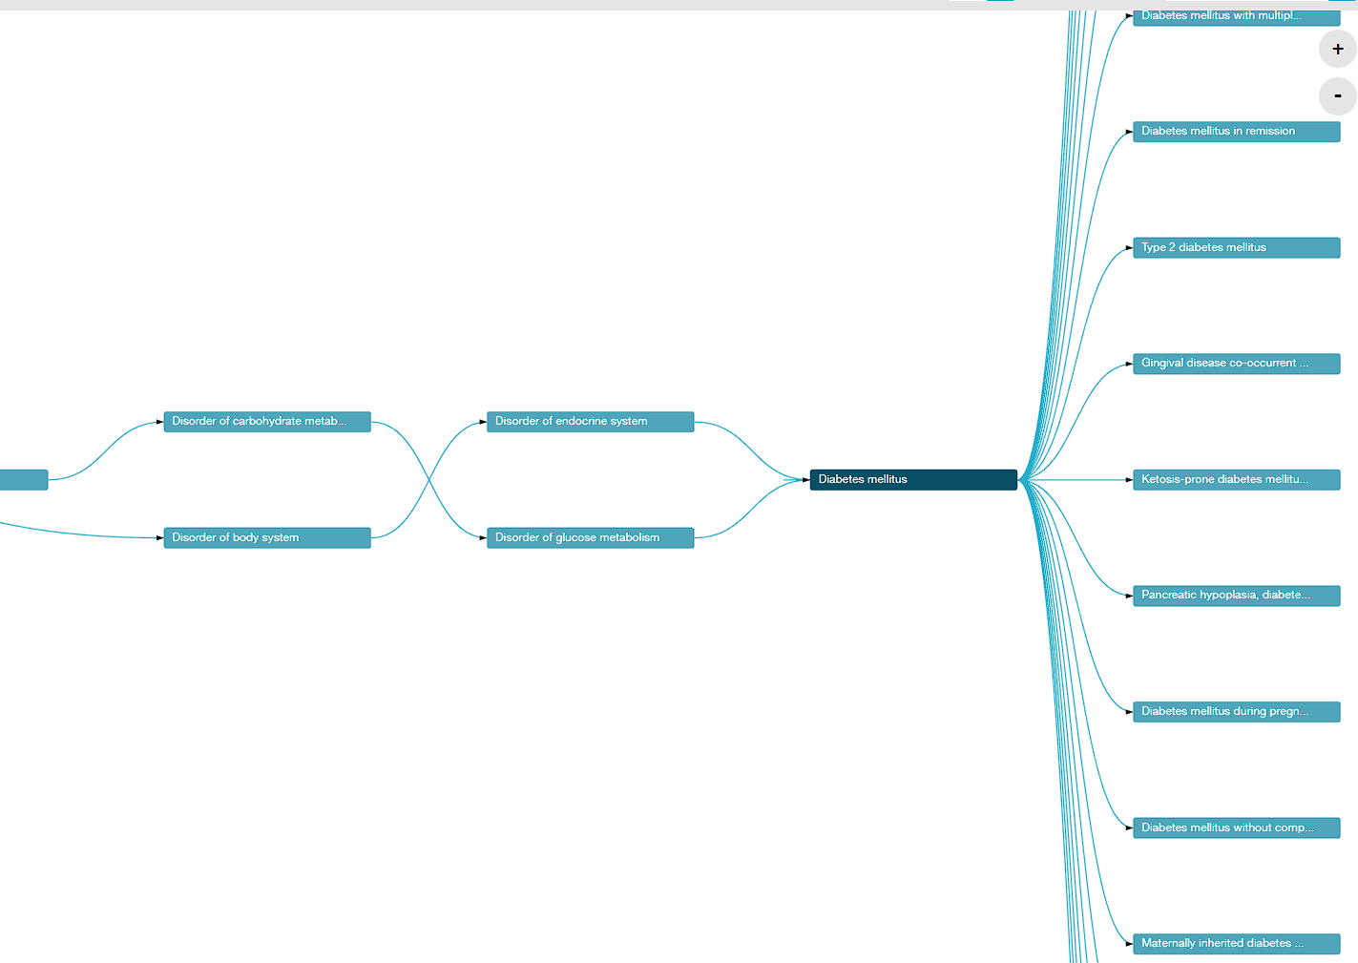
Building blocks
Concept sets / Code lists
List of codes
Included
Exclude: Exclude this concept (and any of its descendants if selected) from the concept set.
Descendants: Consider not only this concept, but also all of its descendants.
Cohorts / Phenotypes
Set of persons who satisfy one or more inclusion criteria for a duration of time
Usually: Concept set/s + logic

Slide 19
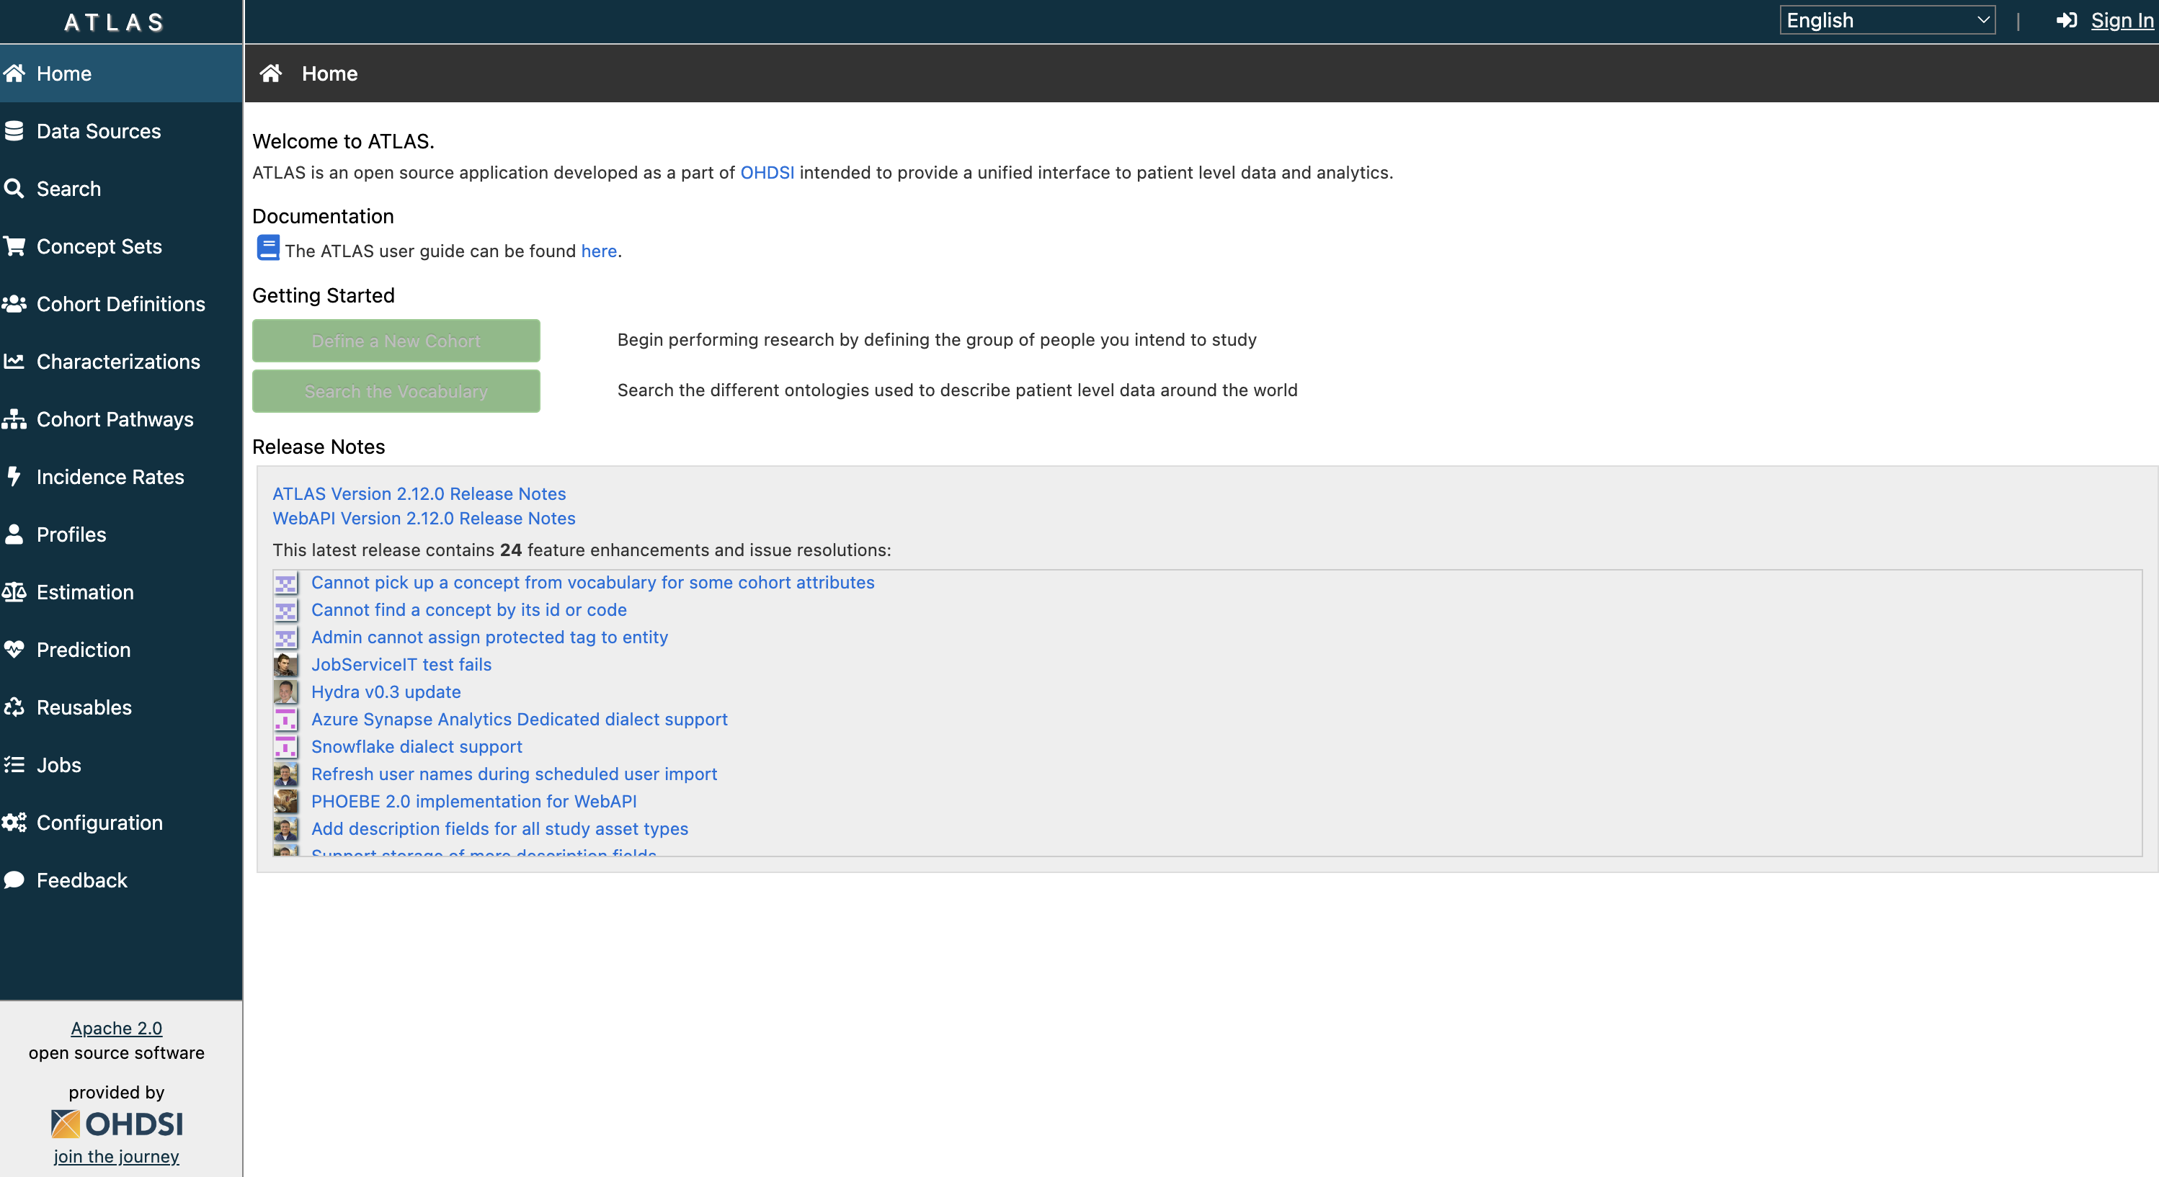
OHDSI’s ATLAS™

Slide 20
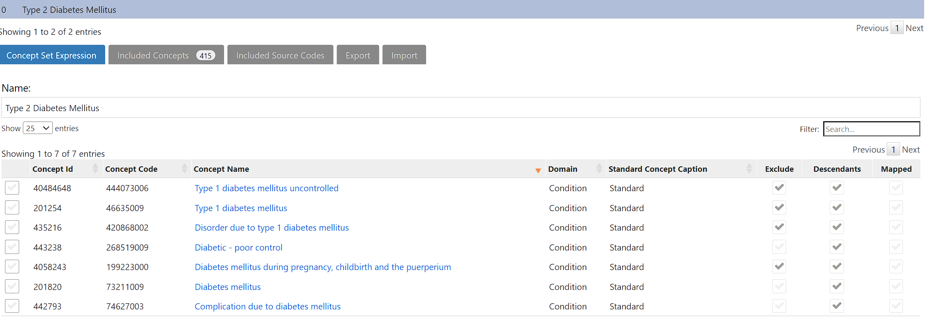
Building blocks: Concept sets in ATLAS™

Slide 21
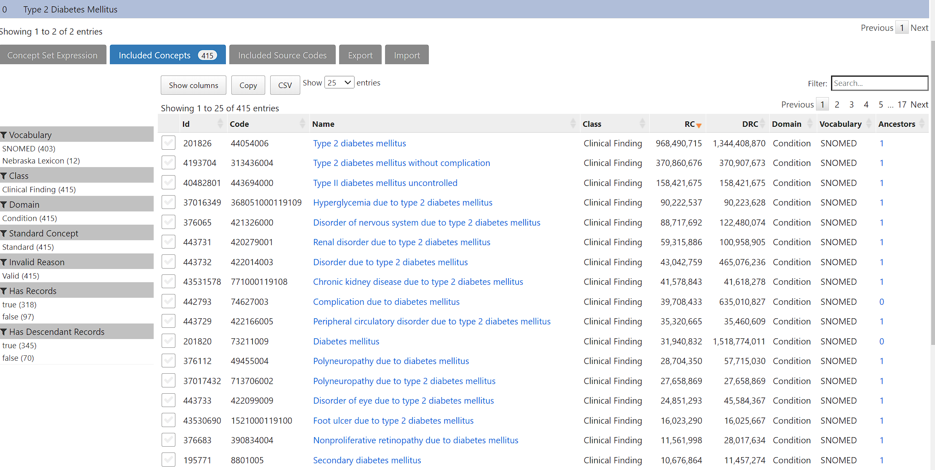
Building blocks: Codelists in ATLAS™

Slide 22
Diabetes Cohort/Phenotype

Slide 23
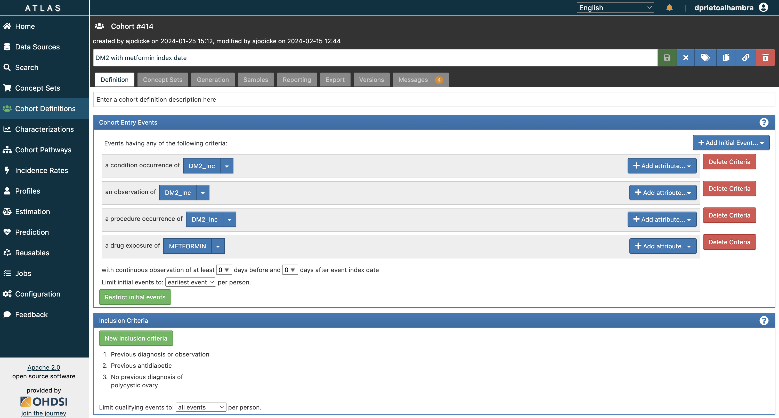
Building blocks (2): Cohorts in ATLAS

Slide 24
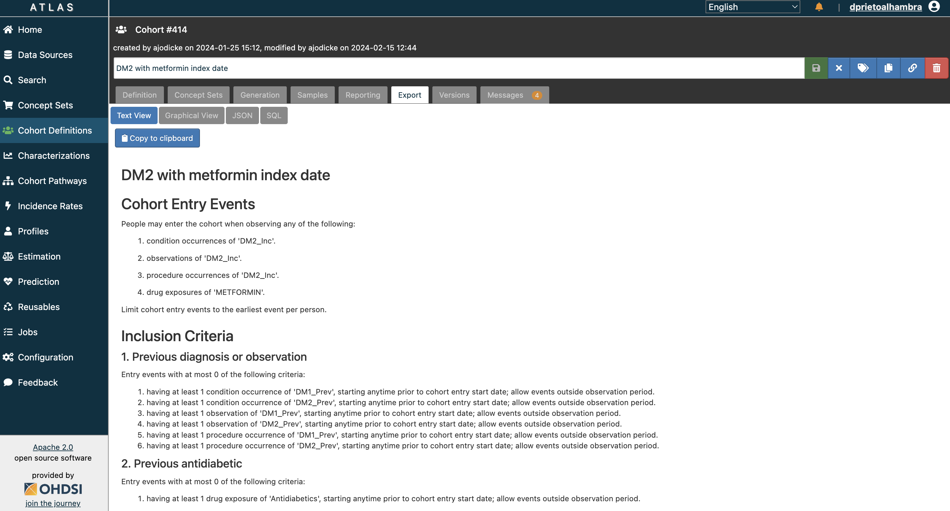
Building blocks (2): Cohorts in ATLAS

Slide 25
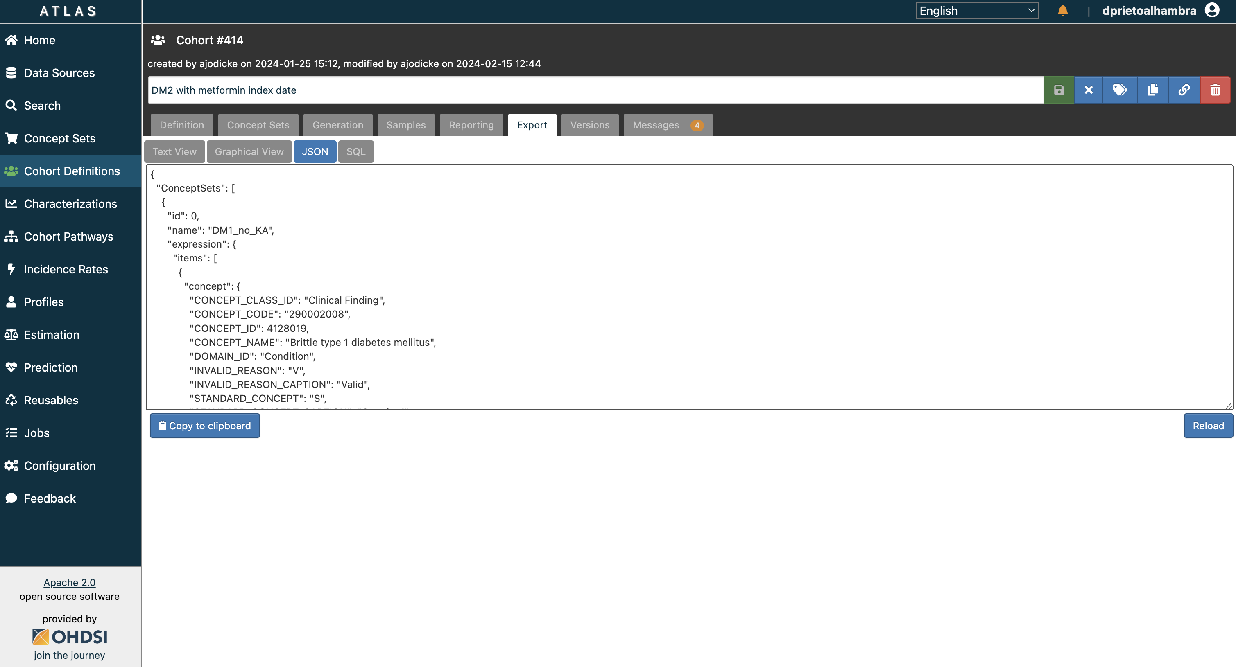
Building blocks (2): Cohorts in ATLAS

Slide 26
AGENDA
Phenotyping in RWD
Federated networks and tools
Phenotyping OMOPped data
The DARWIN EU® Phenotyping process

Slide 27
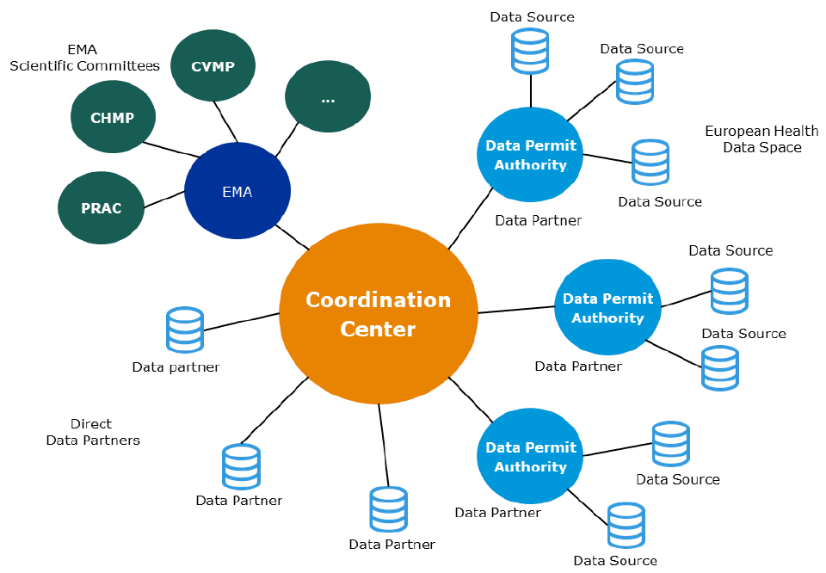
DARWIN EU® is a federated network of data, expertise and services that supports better decision-making throughout the product lifecycle by generating reliable evidence from real world healthcare data
FEDERATED NETWORK PRINCIPLES
Data stays local
Use of Common Data Model to perform studies in a timely manner and increase consistency of results
Notes:
- A Federated Network of Data Holders and expertise, exposing data using a common data model and working under a common governance, set of standards and service levels with regards to studies and analysis of data.
- A Coordination Centre that acts as the entry point into this federated network and manages the network on behalf of EMA and the EMRN.
EMA with strategic control and oversight of operations, e.g. interface with EMA committees, EMA own analysis, driving standards, specifications, guidelines, management of the coordination centre.
Partners who have access to data, or who may request analyses in a data source and provide results to the Coordination Centre. This includes Data Permit Authorities (DPAs), already existing or to be created as part for the European Health Data Space

Slide 28
Generating Real-World Evidence (RWE) from Real-World Data (RWD)
Real-World Data (RWD): routinely collected data relating to patient health status or the delivery of health care from a variety of sources other than traditional clinical trials
Real-World Evidence (RWE): information derived from analysis of real-world data
RWE for regulatory purposes needs to be:
Fast, transparent, scalable and reproducible
Representative (of EU regions)
28

Slide 29
The challenge: TRUE scalability
PHASE I
Establishment – 1st year
PHASE II
Establishment – 2nd year
PHASE III
Operation – 1st year
Operation
2nd year
Operation
3rd year
 | Year 1 | Year 2 | Year 3 | Year 4 | Year 5
Phases | Phase I | Phase II | Phase III | Option 1 | Option 2
Routine Repeated analysis | At least 1 study | - | 30 | 60 | 60
Off the shelf studies | At least 2 studies | 6 + 8 | 30 | 60 | 60
Complex Studies | 1 | 4 | 12 | 24 | 24
Very Complex Studies | 0 | 0 | 0 | 1 | 1
We need tools to allow storing and reuse of phenotypes…

Slide 30
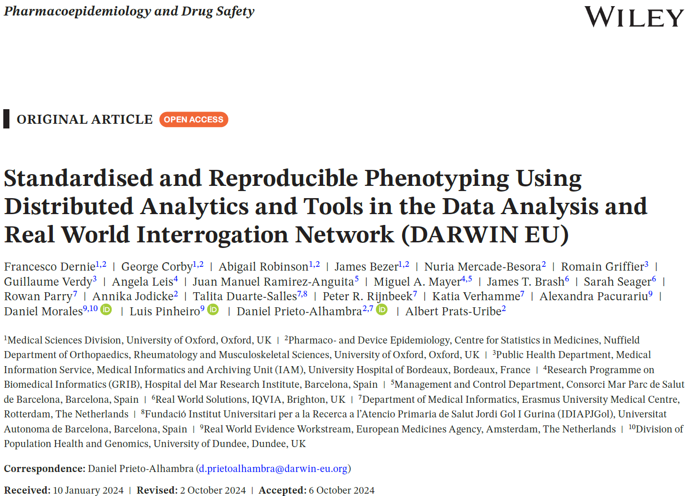

The Process and Tools
https://doi.org/10.1002/pds.70042

Slide 31
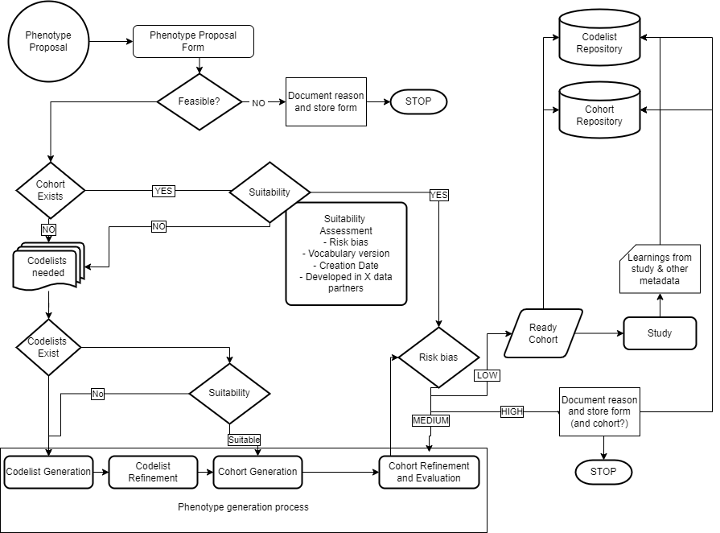
5. DECK
METADATA DB
1. PROPOSAL
Database that follows the process and contains data on all forms and decisions
2. COHORT EXISTS?
Diagnostics DB
Risk of
misclassification
3. CODELIST GENERATION
4. COHORT GENERATION

Slide 32
1. Proposal
Phenotype proposal form
– Who asks? What is it for?
Evaluate:
- Feasibility – If non-feasible – STOP + reason
- Different than study feasibility (but related)
- Need for clinical description
- If yes, clinical description form

Slide 33
Clinical Description
Overview
Presentation
Assessment
Epidemiology
Management/Plan
Prognosis
Disqualifiers (or differentiall diagnoses)
Strengtheners (or pathognomonic signs)

Slide 34
Phenotyping plan
Resultant Proposed Logic
Do we need 1 or more concept sets? Any temporal logic needed?
Proposed Flavours
How many variants or flavours of this phenotype do we need?
Proposed Search strategy
List all proposed concept sets and the proposed keywords that will be used for the search strategy. Also add domains to be searched in, and exclusions if known.

Slide 35
2. Does a suitable cohort exist?
Risk of
misclassification
2.1 Does a cohort exist?
NO – move to 2.2
YES – Suitability and Risk assessment forms
- Suitable/low risk - Ready cohort
- Suitable/Mid risk – move to 4. cohort refinement and evaluation
- Non Suitable/High risk – document in cohort & move to 2.2
2.2 Does a code list exist?
YES – Move to 3.3 Cohort generation
NO – Move to 3. New phenotype generation process

Slide 36
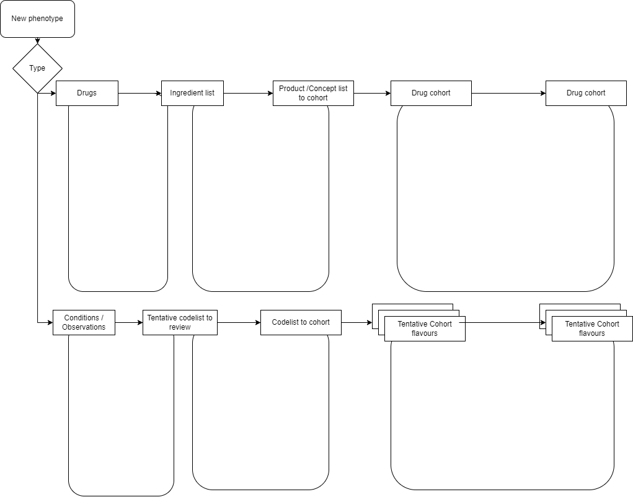
3 - 4
capR
Think about groupings, forms, route, ATC?
Which grouping we first review to avoid a huge list of products?
Drug
Codelist
generator
Code review tool and flavour
Flavours:
Mono
combination
Systemic
local
….
Drug exposure diagnostics
ATLAS
ATLAS
DED review form
Search strategy, vocab & codes reached
Code review results per reviewer
Review form per reviewer and db
DECK
capR
Codelist
generator
Code review tool and flavour
Cohort diagnostics
PPHenotypeR
Flavours:
Narrow,
Wide,
Prevalent,
Inpatient,
Others….
ATLAS
CD review form
PHOEBE
Search strategy, vocab & codes reached
Code review results per reviewer
Review form per reviewer and db

Slide 37
3. New phenotype generation
3.1 – Codelist generation
3.2 – Codelist refinement
3.3 – Cohorts generation

Slide 38

3.1 Codelist generation
Generate a first codelist (systematic way if possible)
That works with all the vocabularies potentially involved
Tools:
Codelist generator

Slide 39
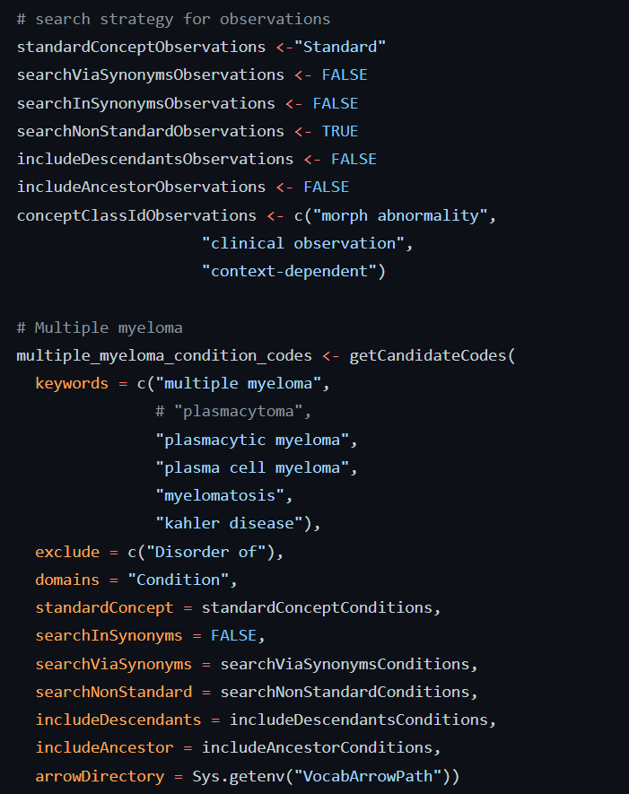
Codelist generator

Slide 40
3.2 Codelist refinement
Clinical review. In DARWIN EU®:
- Two independent reviewers
- Third ‘referee’
Delimitate cohort flavours
- Narrow vs Broad
- Incident vs Prevalent
- Secondary vs Primary vs All
- …

Slide 41
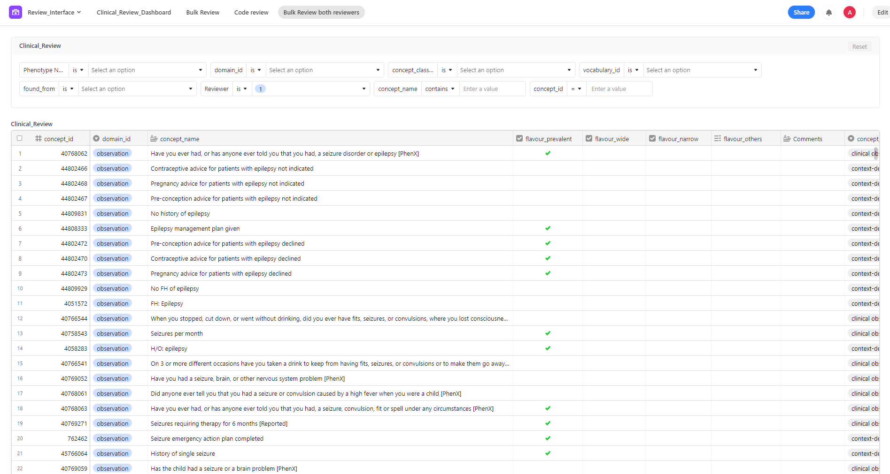
Codelist review

Slide 42
3.3 Cohort definition
Determine end of follow up:
Duration disease/drug use
Death
End of observation
Censor at certain events
Cohort for each flavour:
Determine start of follow up criteria:
Index event/s
Inclusion/exclusion criteria
Time in observation
Tools:
- CohortConstructor
- capR
- ATLAS

Slide 43
4 Cohort review / diagnostics
Make sure cohorts represent what we want
Check for every database:
Included / index concepts
‘Orphan’ (missed) concepts: source or standard
Disease epi – incidence/prevalence ~ previous knowledge
Socio-demographics – age and sex profiles ~ previous knowledge
Work/up etc before index date ~ Clinical Description
Consistent treatments after index date ~ Clinical Description
Overlap between different phenotypes: e.g. broad vs narrow

Slide 44
4 Cohort review / diagnostics (2)
TOOLS
- PhenotypeR (by HDS)
- Cohort diagnostics (by OHDSI) or
- Drug exposure diagnostics (by DARWIN EU®) or
+
Phenotype/cohort diagnostics review form
Drug exposure review form

Slide 45
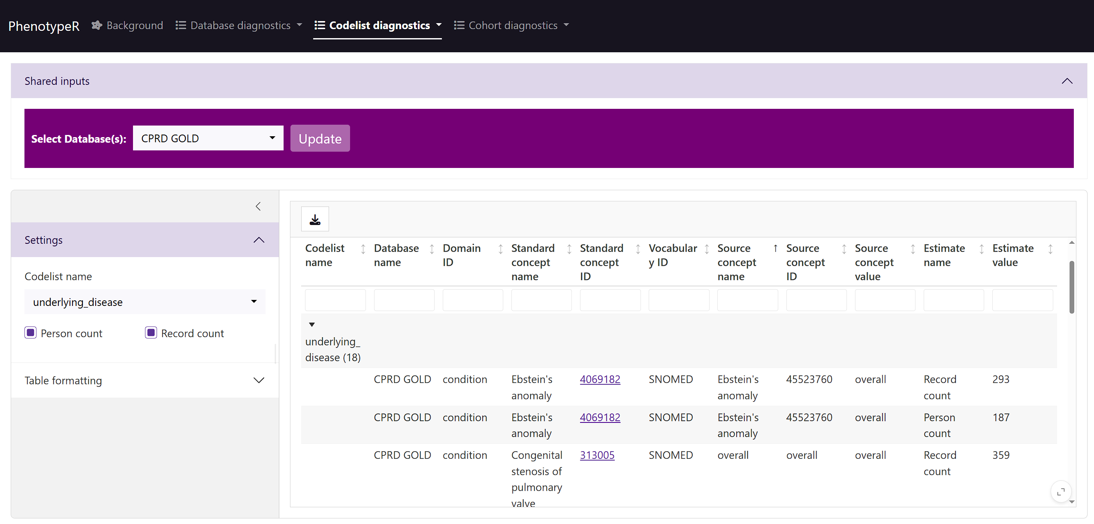

Slide 46
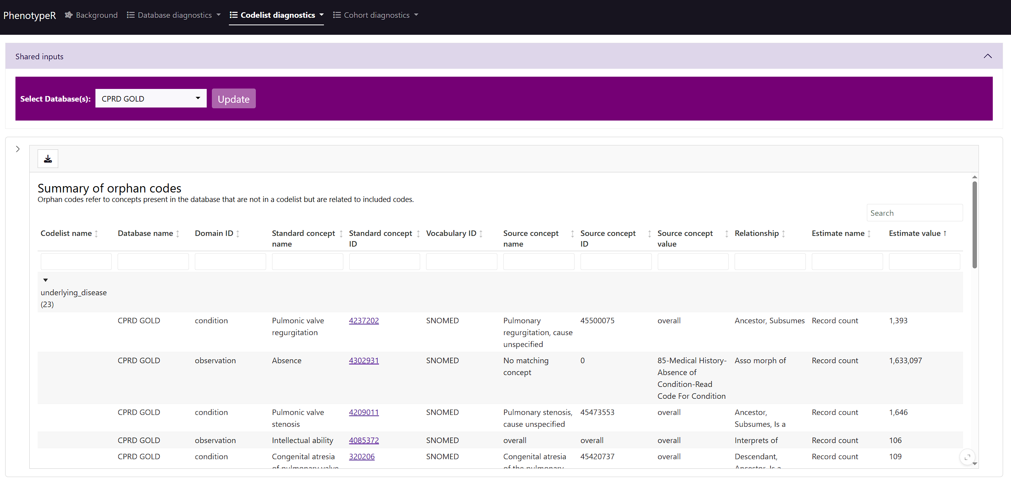
Orphan codes review

Slide 47
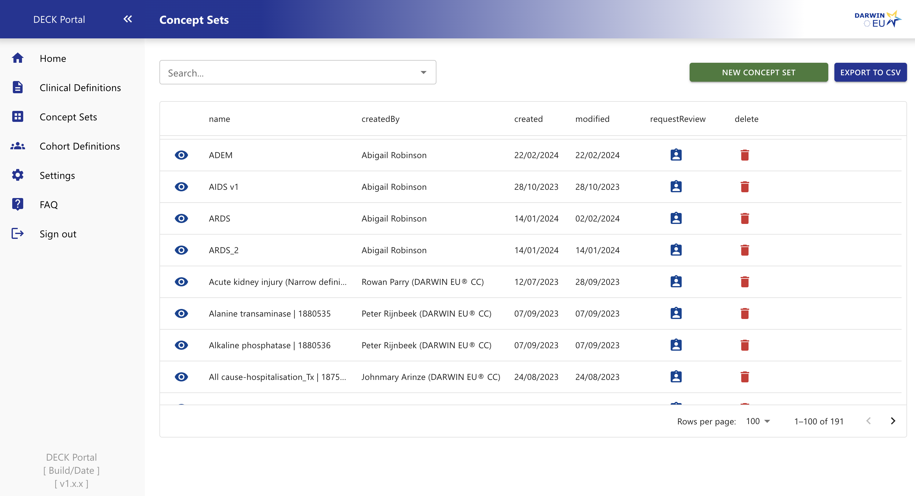
5 – DECK Portal
Store cohort definitions in DECK
- for indications: happy with cohort diagnostics
- for regulatory outcomes: EMA / senior approval
All metadata stored and reusable for future studies

Slide 48
DECK
METADATA DB
Database that follows the process and contains data on all forms and decisions
Diagnostics DB
Risk of
misclassification

Slide 49
Conclusion
Phenotyping is difficult!
More in federated networks
We need to ensure transparency, traceability, and reproducibility
Quality control and diagnostics are crucial
We are going to practice this afternoon!

Slide 50
QUESTIONS?
albert.prats-uribe@ndorms.ox.ac.uk

